Slide 1






SMART KEY CHAIN

Slide 2

TEAM MEMBERS:
2210030372_LALITHA
2210030388_TULASI
2210030338_TRISH
221003030341_HEMA
2210030505_SUMER
2210030304_ANUSHA

Slide 3
PROBLEM STATEMENT:
Smart KeyChain system to enhance key management and prevent the loss or misplacement of keys.

Slide 4

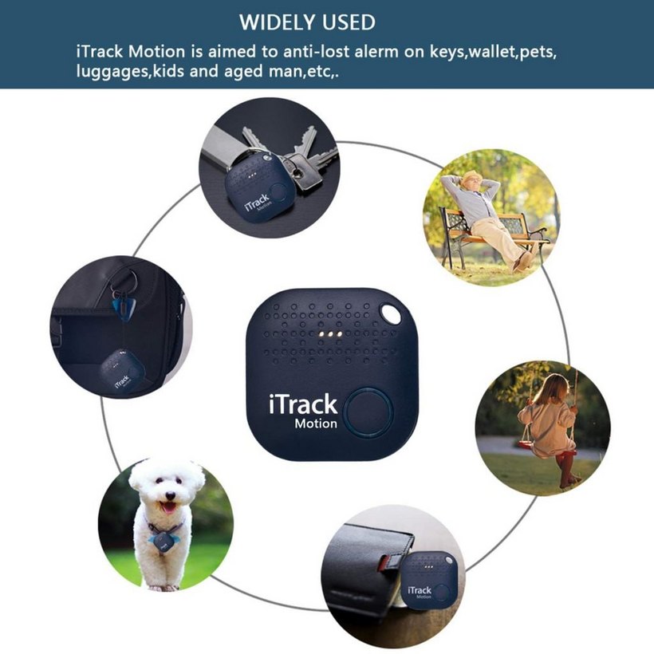

INTRODUCTION SMARK KEY CHAIN
IoT Based Smart Key Finder is a revolutionary solution for easily locating misplaced keys. It utilizes Internet of Things (IoT) technology to connect the key finder to a smartphone other
devices.With this smart device, users can save time and eliminate the frustration of searching for lost keys.

Slide 5

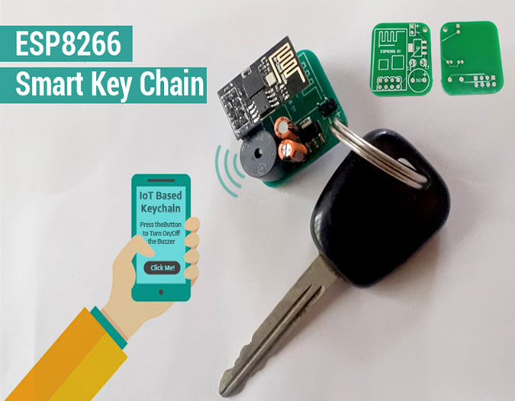
Smart Key Finder Works
The smart key finder is equipped with Bluetooth technology which allows it to connect to a smartphone or other devices.
Users can download a dedicated mobile application that pairs with the key finder.
The mobile application sends signals to the key finder to locate the keys within a certain range.

Slide 6



Key Features
Real-time Location Tracking: Users can track the exact location of their keys in real-time using the mobile application.
Range Alert: The key finder sends an alert when the keys are out of the specified range, preventing loss or theft.
Audible Alarm: Users can activate an audible alarm on the key finder to easily locate their keys within the vicinity.

Slide 7



COMPONENTS USED:
ESP8266-01
AMS1117 3.3V Voltage Regulator
Buzzer
Lithium polymer battery
2x10f capacitor

Slide 8

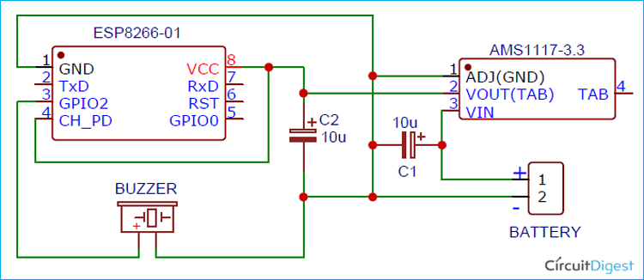
Benefits
Time-saving: Users no longer need to spend valuable time searching for misplaced keys.
Stress-free: The smart key finder eliminates the frustration and stress of losing keys.
Cost-effective: By avoiding the need for key replacements, users can save money in the long run

Slide 9

Compatibility and Integration
IoT Based Smart Key Finder is compatible with both Android and iOS devices.
It can be integrated with various smart home systems for added convenience.
The key finder can also be easily synchronized with other IoT devices, such as smart locks.

Slide 10

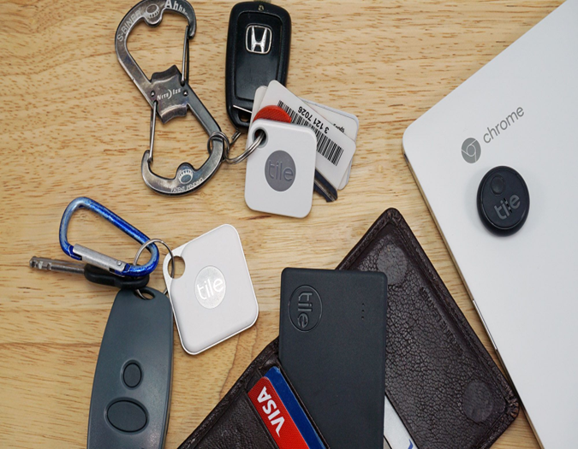


Security and Privacy
The mobile application and key finder utilize encryption protocols to ensure data security.
Users have full control over their data and can choose to share it only with trusted devices.
Personal information is kept confidential and is not shared with any third parties

Slide 11



Battery Life and Charging
The key finder is equipped with a long-lasting battery that can last for several months.
It can be easily recharged using a USB cable or wireless charging pad.
Users receive low battery notifications on their smartphones to ensure uninterrupted functionality.

Slide 12



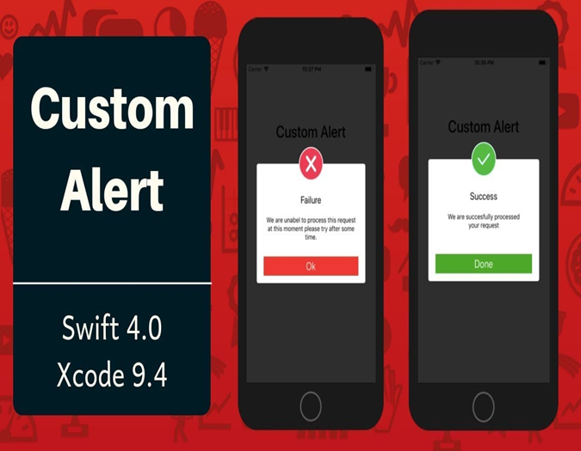

Additional Features Options
Customizable Alerts: Users can personalize the alert settings for different scenarios, such as silent mode or vibration.
Multiple Key Tracking: The mobile application can track multiple key finders simultaneously, ideal for managing multiple sets of keys.
Community Network: Some key finder systems have a community network feature, where users can report lost keys and receive help from others.

Slide 13

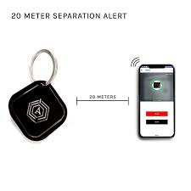
Conclusion
IoT Based Smart Key Finder is a game-changer in the world of key management and security.
Its innovative features, ease of use, and ability to save time make it a must-have device for individuals and families.
Embrace the power of IoT and never lose your keys again with IoT Based Smart Key Finder.

Slide 14


Thank you!

